Slide 1

IDENTIFYING GESTATIONAL DIABETES RISK IN PREGNANT WOMEN
Tamer Ayoub, Ebenezer Sefenu, and Abbi MaKarrall

Slide 2

OBJECTIVES
01
02
03
CLEANING THE DATA
DATA VISUALIZATIONS
LOGISTIC REGRESSION MODELS
04
05
06
WEAKNESSES
KEY POINTS
FURTHER IMPROVEMENTS

Slide 3

Our Sample
All patients in the dataset are women of at least 21 years of age.

Slide 4

CLEANING THE DATA

Slide 5
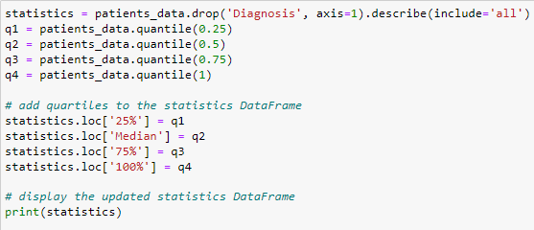
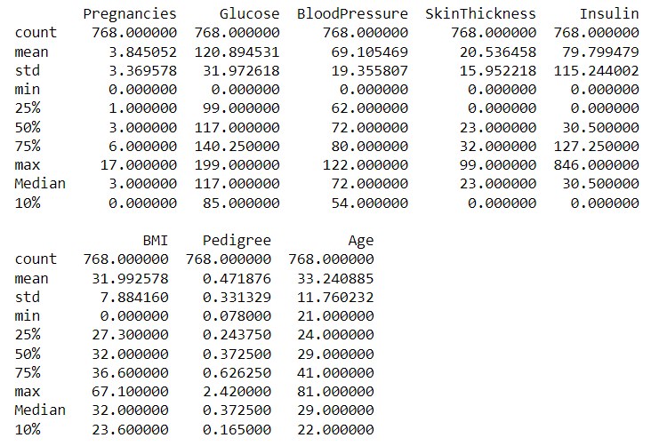
DESCRIPTIVE STATISTICS (WHY?)
768 rows per column
Average age is 33 years old
Glucose, Blood Pressure, and Insulin have the highest standard deviation (variance).
You can tell right away, we have some outliers when looking at the max/min for Insulin, Blood Pressure, Insulin, BMI, and Glucose

Slide 6
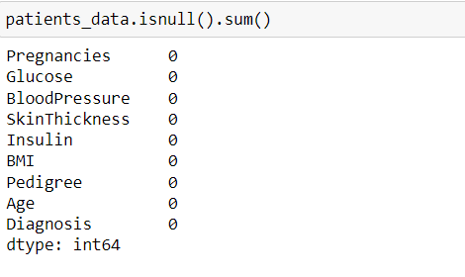
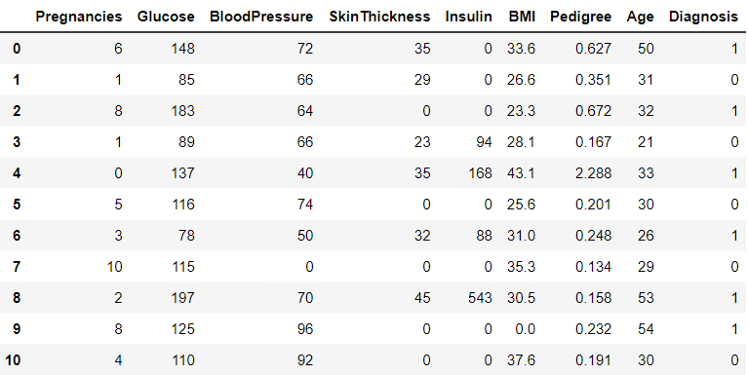
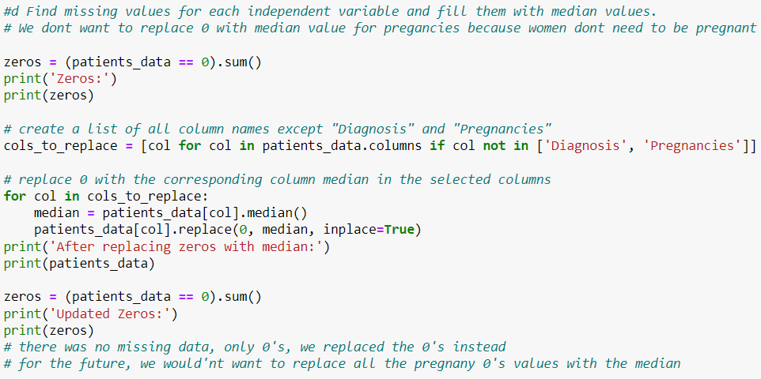
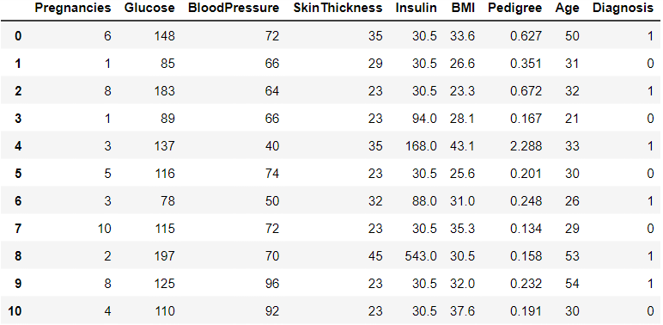
FINDING MISSING VALUES (No Nulls?)
BEFORE
AFTER
We didn’t replace the 0's w/ the median for Pregnancies because women don't need to be pregnant

Slide 7
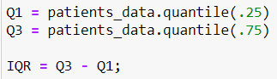
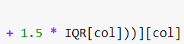
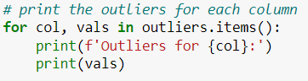
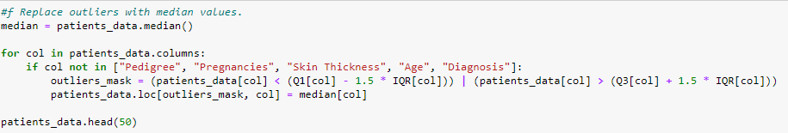
HANDLING OUTLIERS
Just because it falls outside IQR * 1.5, doesn't always make it a ILLEGITIMATE OUTLIER
Some outliers are natural occurrences and should be left alone.
Using the IQR Rule to find outliers:
Replaced outliers with median values (Except Pedigree, Pregnancies, Skin Thickness, Age and Diagnosis (WHY?):

Slide 8

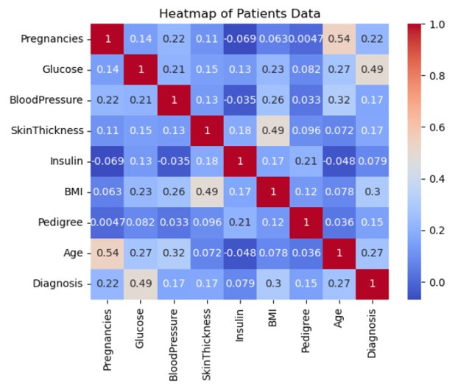
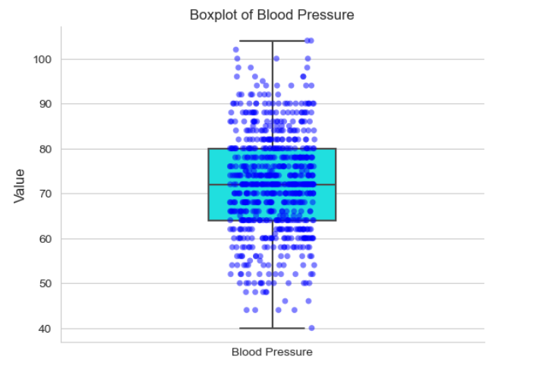
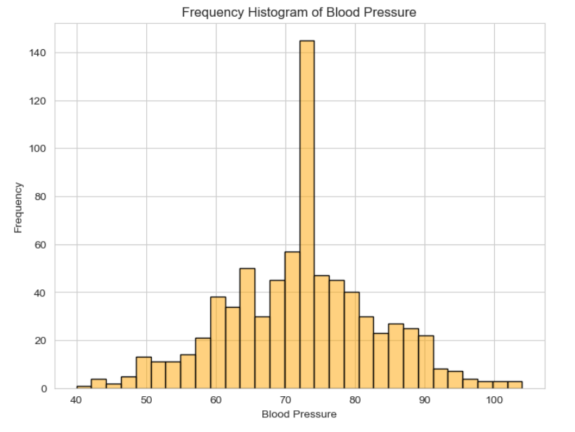
DATA VISUALIZATIONS AND INSIGHTS..

Slide 9
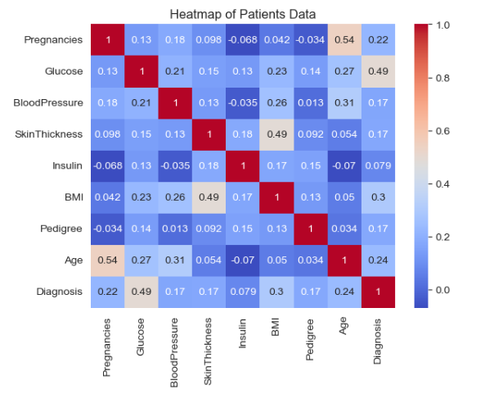
HEAT MAP VISUALIZATION (Why?)
No Correlation
Correlated
CORR. 3 VAR.
BMI
Age
Glucose
LESS CORR. VAR.
Blood Pressure
Skin Thickness
Pedigree
Insulin

Slide 10
HANDLING MULTI-COLLINEARITY
We have Multi-collinearity w/ independent variables such as:
Pregnancies and Age
Skin Thickness and BMI
How to move forward w/ this new insight?

Slide 11
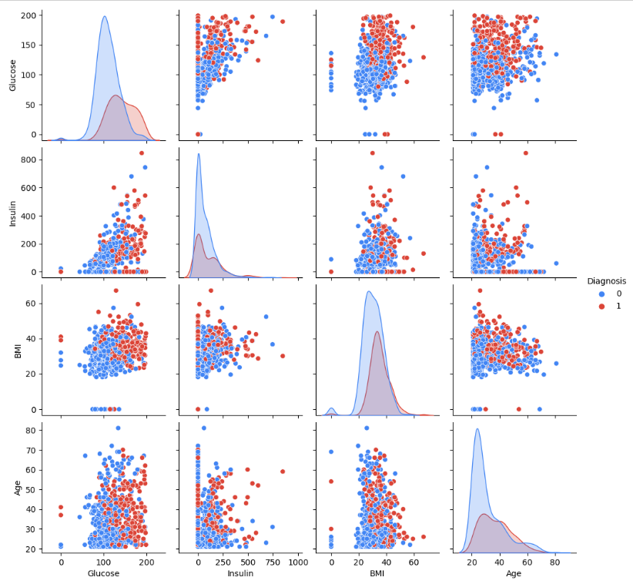
LINEAR-CORRELATION FINDINGS
As BMI increases, glucose increases.
Women with high glucose levels have high insulin levels.
There is no correlation between BMI and Insulin. (There could be several reasons why there is no correlation between BMI and insulin)
Such as: Confounding variables: Other variables that affect insulin levels are diet, exercise, and genetics.
Notes:
There is a linear correlation between insulin and glucose,
# but in the heatmap, the correlation is mentioned very low (why?)
If the linear correlation between two variables is strong, but the heatmap shows very low correlation, it's likely that there is a non-linear relationship between the two variables.

Slide 12

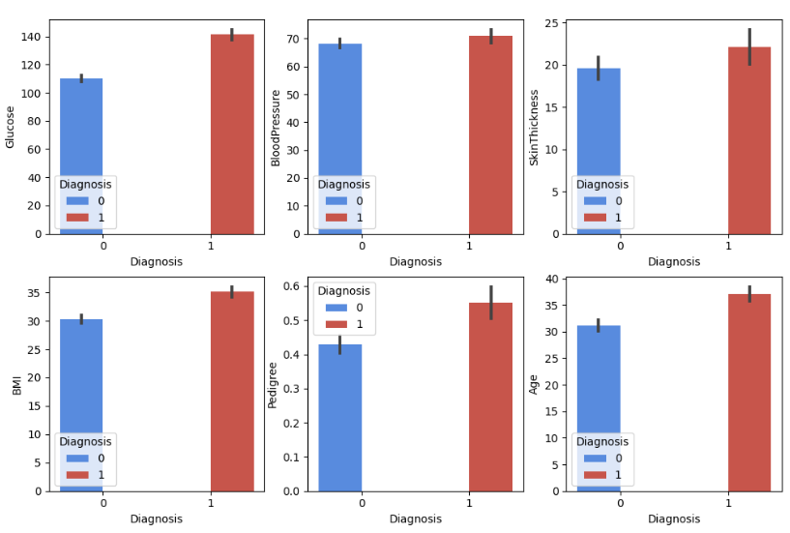
LINEAR-CORRELATION FINDINGS
In this data visualization the subplot shows female patients who diabetic, then not diabetic. Why?
Notes:
Our logistic regression model is better at predicting non-diabetic individuals, this may be due to an imbalance in the data, where there are more non-diabetic individuals than diabetic individuals. In this case, the model may be biased towards predicting non-diabetic individuals, and may not perform as well in predicting diabetic individuals.

Slide 13
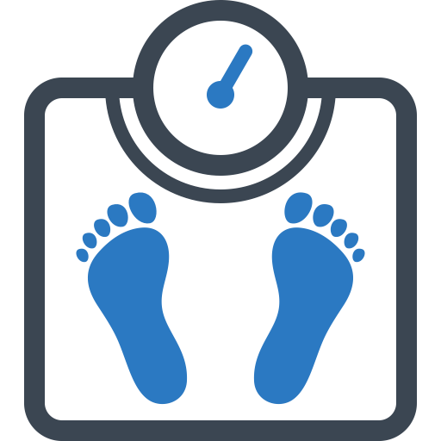


TOP 3 SELECTED BEST FEATURES
[8]
[10]
[11]
Age
BMI
Glucose

Slide 14
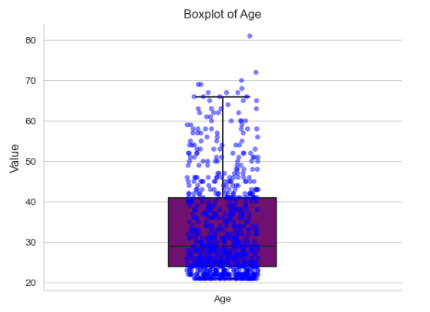
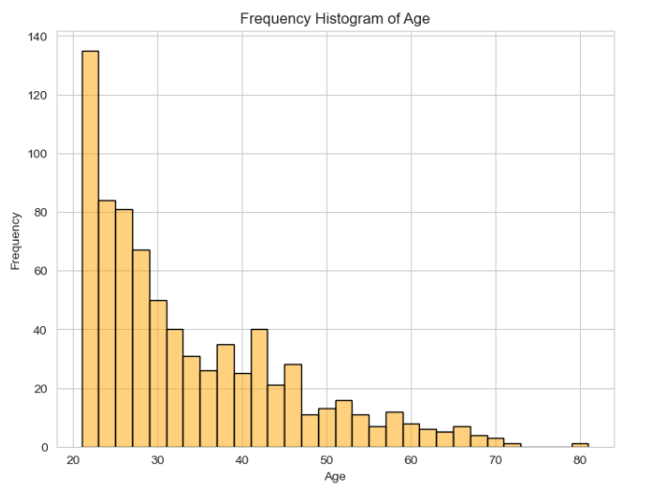
Age
On average, our sample included women whose average age was 33, and median age was 29.
"Type 2 diabetes most often develops in people over age 45, but more and more children, teens, and young adults are also developing it." [2]

Slide 15
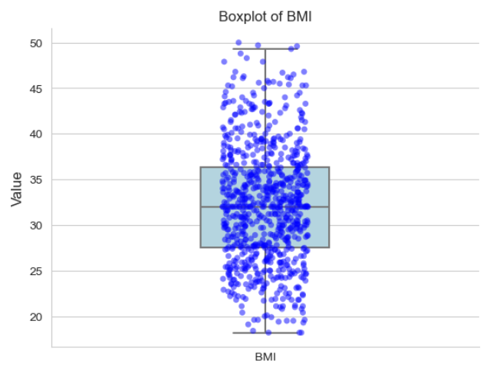
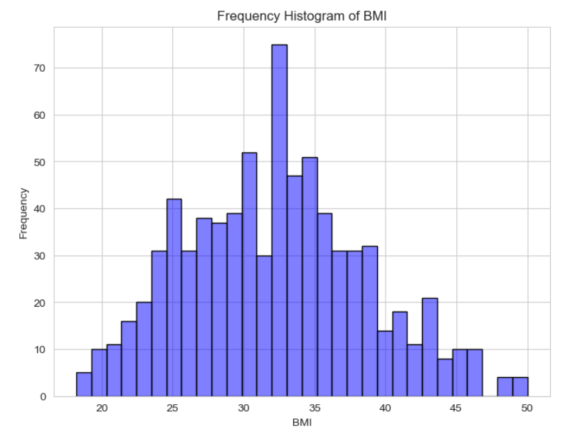
BMI
On average, our sample included women whose average age was 33, with an average BMI of 31.99, and a median BMI of 32.
"Being overweight (BMI of 25-29.9), or affected by obesity (BMI of 30-39.9) or morbid obesity (BMI of 40 or greater), greatly increases your risk of developing type 2 diabetes. The more excess weight you have, the more resistant your muscle and tissue cells become to your own insulin hormone. More than 90 percent of people with type 2 diabetes are overweight or affected by a degree of obesity."[1]
What could this all mean?

Slide 16

So Far, what is our data telling us?
In our sample, we were dealing with women with an average age of 33 and with a BMI of 31.99; leading to a discovery that on average, women in our sample were Obese, but most of the women were most likely not diagnosed yet since studies show most people are diagnosed around the age of 45 and above.
[9]

Slide 17
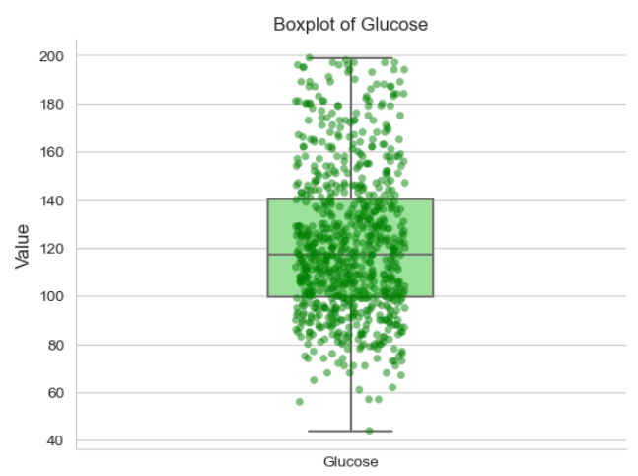
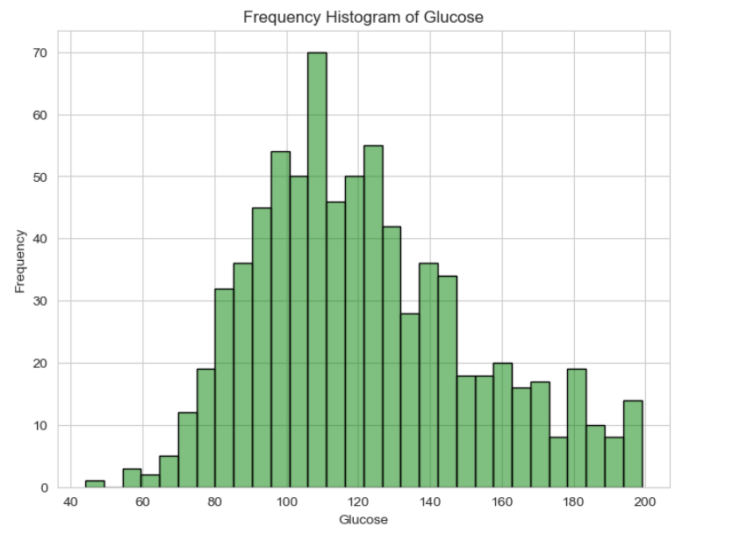
Glucose
On average, our sample included women whose average age was 33, with an average BMI of 31.99, and a median BMI of 32, with an average blood sugar (glucose) level of 120.9 , and a median of 117.
"This measures your blood sugar after an overnight fast (not eating). A fasting blood sugar level of 99 mg/dL or lower is normal, 100 to 125 mg/dL indicates you have prediabetes, and 126 mg/dL or higher indicates you have diabetes." [3]
So, what can we say after analyzing the data?

Slide 18
On average, our sample contained Women who are likely Pre-diabetic
[4]

Slide 19
LOGISTIC REGRESSION MODELS

Slide 20
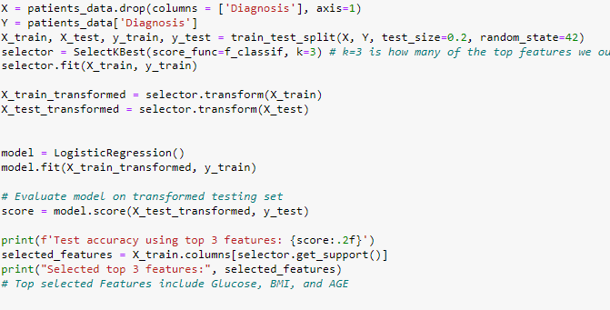
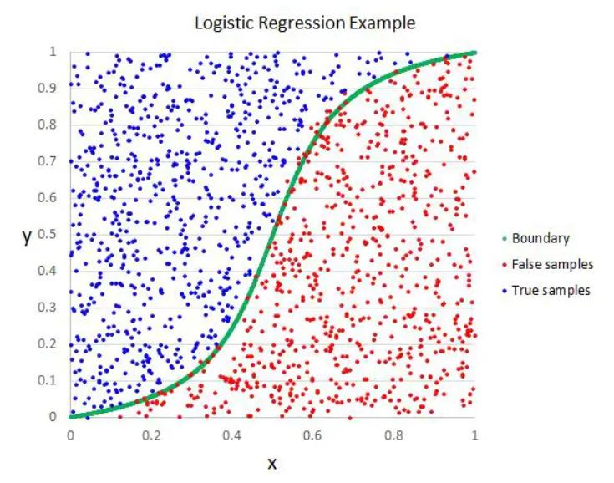
LOGISTIC REGRESSION MODEL 1 (BEST FEATURES ONLY)
BUT HOW DOES THIS WORK?

Slide 21
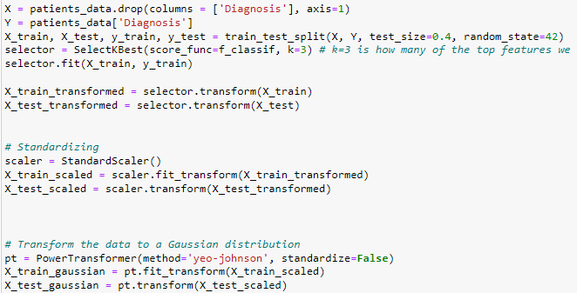
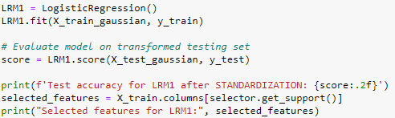
LRM1 (BEST FEATURES ONLY - STANDARDIZED)
BUT HOW DOES THIS WORK?

Slide 22
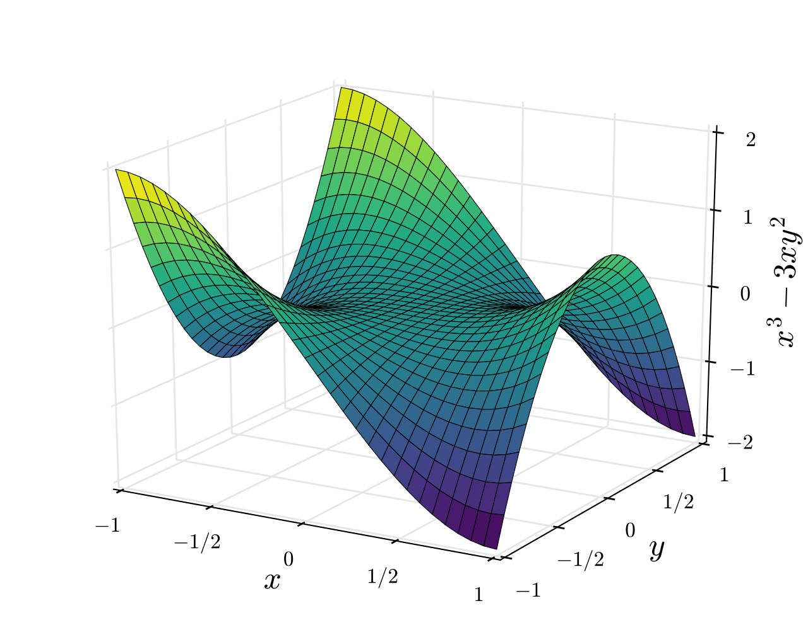
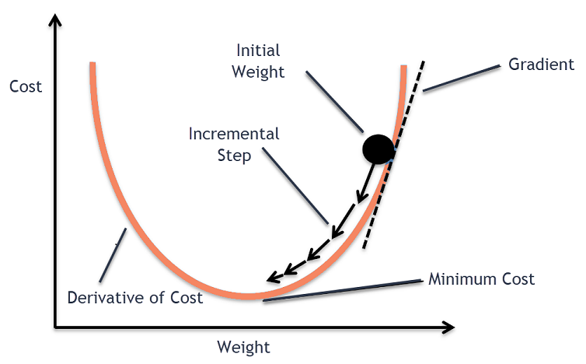
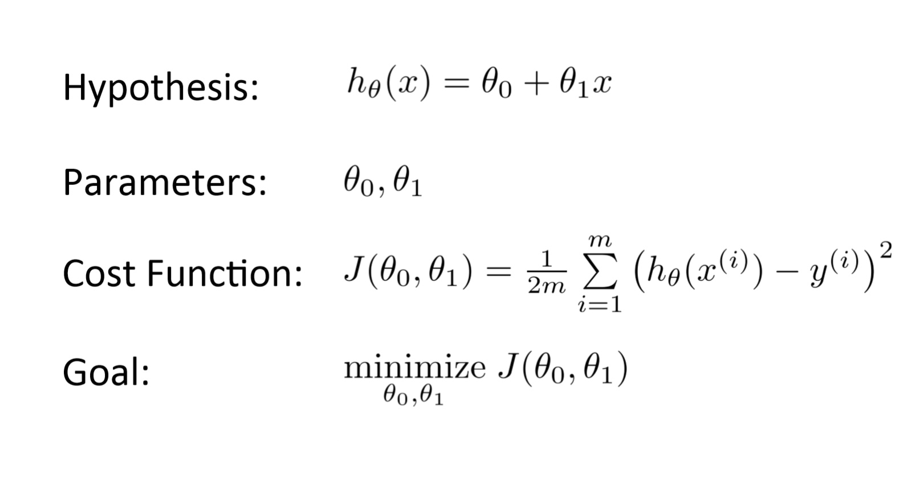
GRADIENT DESCENT (What is it?)
"Gradient descent is an optimization algorithm used in machine learning to minimize the cost function of a model by iteratively adjusting its parameters in the opposite direction of the gradient. The gradient is the slope of the cost function, and by moving in the direction of the negative gradient, the algorithm can converge to the optimal set of parameters that best fits the training data. Gradient descent can be applied to a wide range of machine learning algorithms, including linear regression, logistic regression, neural networks, and support vector machines." [5]
[8]
"The continuous goal is minimize the Cost Function. When we minimize the Cost Function, we minimize the error, and consequently, improve the performance of our Model." [6]
[7]
[7]

Slide 23
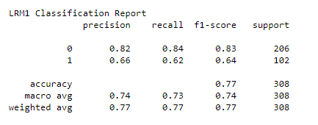
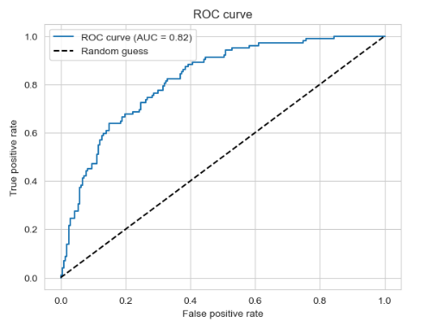
LRM1 CLASSIFICATION REPORT
Top 3 best features: Glucose, BMI and Age
Compared to LRM2, slightly higher accuracy when predicting if someone is not diabetic.
F1 score of 83% when predicting if someone is not diabetic.
F1 Score – The precision + Recall / 2 ( The Mean )
Precision – The proportion of all true positives
Recall – How complete was the accuracy ( did accuracy withhold )
ROC (Receiver Operator Characteristic)
AUC (Area under the Curve) = .82
The higher the AUC, the better the model is at distinguishing the positive and negative classes
True Positive: How accurate the model predicts women who are diabetic, to be diabetic
False Positive: How inaccurate the model is, predicting non-diabetic women to be diabetic

Slide 24
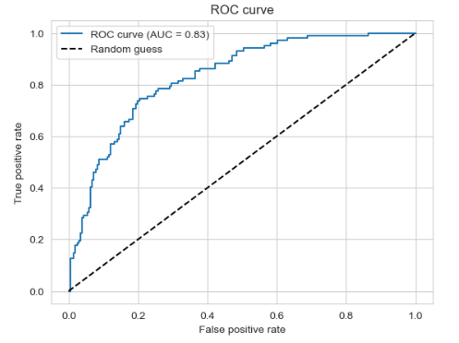
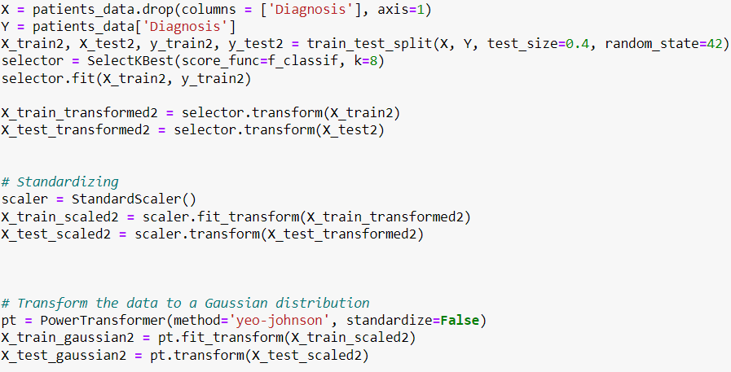
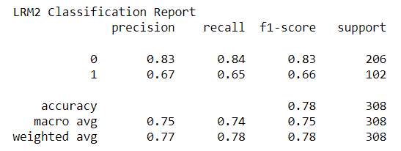
LOGISTIC REGRESSION MODEL 2 (ALL INDEPENDENT VARIABLES)
All independent features used
Compared to LRM1, slightly higher accuracy when predicting if someone is diabetic
Accuracy: 78%
AUC (Area under the Curve) = .83

Slide 25
DECISION-TREE CLASSIFIER MODEL

Slide 26
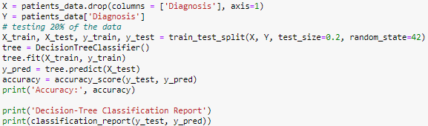

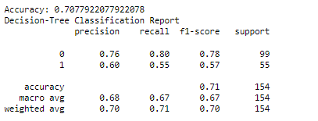
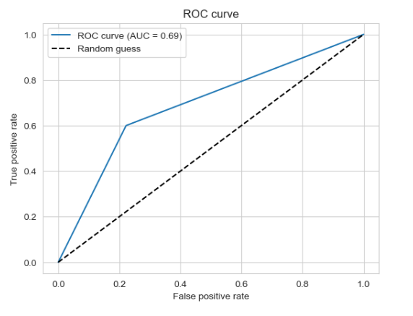
DECISION-TREE CLASSIFIER MODEL
[12]
AUC score of .69, not as performative as the other models
Accuracy score of 71%
Better at predicting who is not diabetic
Easy to visualize because of its “if-else” structure

Slide 27
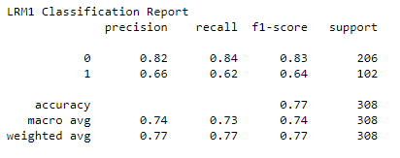
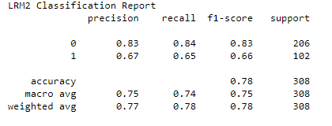
COMPARING THE MODELS
New Insights:
- Our models has more precision predicting non-diabetic, than diabetic
- LMR2 is the most accurate and performative model

Slide 28
FURTHER IMPROVEMENTS
We can collect more data that has a high correlation to developing diabetes using better random sampling methods (Not enough Data) .
Increase our sample size and collect more representative data.
Re-visualize and re-select our best features afterwards.
Re-clean our data being more distinct in what values get dropped or replaced.
We need to re-collect our data; our data is biased and contains on average data about pre-diabetic women.

Slide 29
PITFALLS AND WEAKNESSES
Our model is not 100% accurate, so we need to consider false positives and false negatives.
Possibly unnecessary treatment or missed diagnoses
Our model does not account for all confounding variables.
Health, diet, exercise, genetics etc.
Our model is biased and imbalanced towards class 0. Our model might have high specificity but low sensitivity towards non-diabetic, it may be better at predicting non-diabetic individuals but may miss many diabetic individuals.
Is it reflective of the entire population? No, on average our data likely contained women who were 33 years old and prediabetic with slight obesity (cannot be externally validated).

Slide 30
TOP FIVE KEY POINTS
Our model shows promising results with an overall accuracy score of 78%, but there is room for improvement.
We recommend collecting more data with additional features to improve the accuracy of our model. The sample size may not be large enough to detect a significant correlation between variables. With a small sample size, the correlation coefficient may be subject to greater variability and less reliable. We don’t have enough DATA.
Given that logistic regression models base their predictions on probabilities, which means that there is always some degree of uncertainty in the forecasts, we advise using our model as a tool to assist clinical decision making rather than as a replacement. Keep in mind, our Model is Biased towards women who are mostly likely on average pre-diabetic, obese and 33-year-olds. (Should not be applied externally in other environments/populations)
The external validity of our findings may be limited due to the sample size, not a good enough random sample, and bias; so it may be difficult to apply our results to other populations.
The F1-score is higher for class 0 in our model, indicating that it is better at identifying non-diabetic patients. This is likely due to our imbalanced dataset.

Slide 31
Sources
[1] https://www.honorhealth.com/medical-services/bariatric-weight-loss-surgery/patient-education-and-support/comorbidities-type-2-diabetes#:~:text=What%20you%20consume%20throughout%20your,of%20developing%20type%202%20diabetes.
[2] https://www.cdc.gov/diabetes/basics/type2.html#:~:text=Type%202%20diabetes%20most%20often,adults%20are%20also%20developing%20it.
[3] https://www.cdc.gov/diabetes/basics/getting-tested.html#:~:text=A%20fasting%20blood%20sugar%20level,higher%20indicates%20you%20have%20diabetes.
[4] https://news.yale.edu/2020/02/04/studies-suggest-new-path-reversing-type-2-diabetes-and-liver-fibrosis
[5] https://www.analyticsvidhya.com/blog/2020/10/how-does-the-gradient-descent-algorithm-work-in-machine-learning/
[6] https://medium.com/analytics-vidhya/cost-function-explained-in-less-than-5-minutes-c5d8a44b918c#:~:text=The%20continuous%20goal%20is%20minimize,the%20performance%20of%20our%20Model.
[7] https://www.analyticsvidhya.com/blog/2020/10/how-does-the-gradient-descent-algorithm-work-in-machine-learning/
[8] https://www.pngwing.com/en/free-png-cnwfi/download
[9] https://www.123rf.com/photo_138869311_male-doctor-with-doubt.html?vti=mdb7vgvesmsw00laes-1-6
[10] https://creazilla.com/nodes/5627029-blood-sugar-clipart
[11] https://pngtree.com/element/down?id=NzQ5NDE2MQ==&type=1&time=1681678714&token=ZmQyNjQ3ZjI3NjhkNzQ4ZDQ2NGU4NTdiNzVlYTlmZDc=\\
[12] https://www.javatpoint.com/machine-learning-decision-tree-classification-algorithm
[13] http://primo.ai/index.php?title=Logistic_Regression_%28LR%29

Slide 32
THANK YOU QUESTIONS?

